Slide 1
Family Day – Mill City Museum 12:00-4:00 April 12, 2014

Slide 3
SING THE SONG TOGETHER

Slide 4
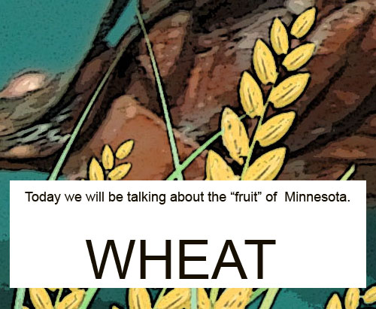
FRUIT any product of plant growth useful to humans or animals

Slide 7
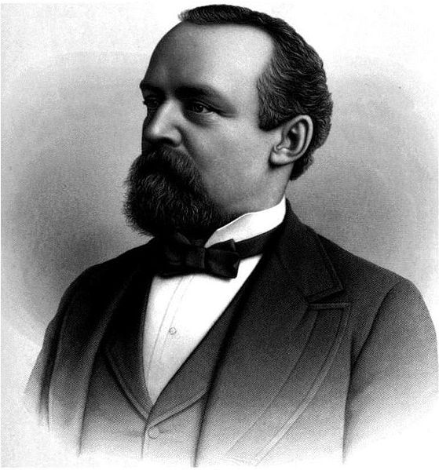
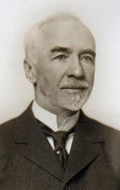
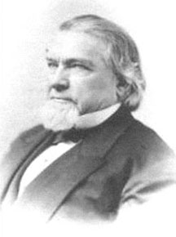
.
These men started wheat companies. Have you seen these names before? Where?
z
Pillsbury Dunwoody Washburn
The Stone Arch Bridge was built in the 1800s. Have you walked on this bridge? It is still there today?

Slide 8
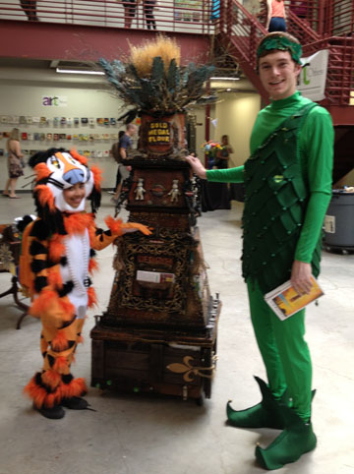
Can You Name These Icons?

Slide 9
Discuss Ode To Gluten
Is this Art?
Do you recognize any of the objects?
Why do you think the artist made this art work?
What is your favorite food made from wheat?

Slide 10
Design YOUR memory object art work here. Think about the metaphor “message” you want to deliver. Metaphor: Words, phrases or object s that refers to a new idea not literally connected. Example: A heart, a cow and wheat are like a farm.

Slide 11
Write your artist statement here. Include the meaning of the objects and how you relate to the meaning. Why is the artwork important to you? Where did you get your idea?

